Slide 1
Designing an Intelligent Accommodation System for Rohingya Refugees: Integrating AI, Sustainability, and Economic Empowerment.

Slide 2
Designing an Intelligent Accommodation System for Rohingya Refugees: Integrating AI, Sustainability, and Economic Empowerment.
Group No : 09
SL No
Name
ID
22-46013-1
22-47018-1 22-47019-1
09 29 30
Md. Shohanur Rahman Shohan Farjana Yesmin Opi
Md. Abu Towsif

Slide 3
Designing an Intelligent Accommodation System for Rohingya Refugees: Integrating AI, Sustainability, and Economic Empowerment.

Slide 4

Table of contents
About the research background, related studies, obejectics and research contribution
01
Results & Analysis What we have found from our methodology, Our proposed solution
03
Conclusion Summary of the study, Limitations, Future Research
04
Methodology About Search strategy, Selection Process , Data Extraction
02

Slide 5
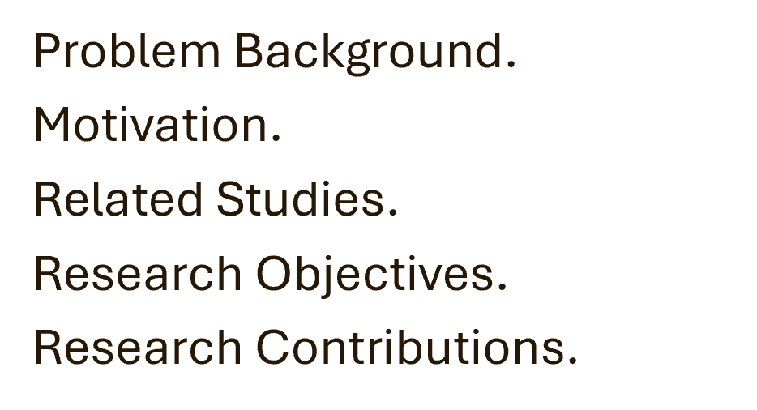
01
Introduction

Slide 6
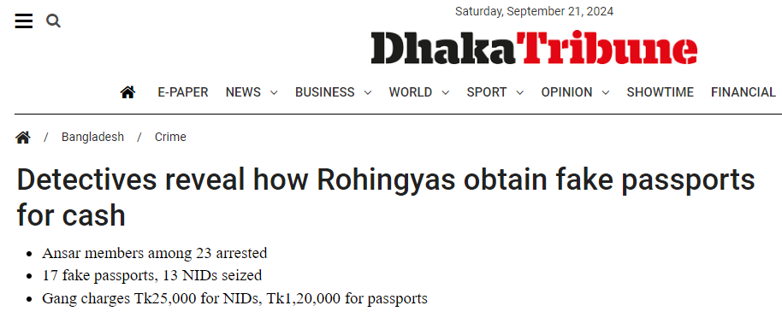

Problem Background
1.1
Rohingya - An ethnic minority from Myanmar
Over 1 million Rohingya in Bangladesh.
Existing camps focus on immediate relief but lack long-term sustainability.
Inadequate living conditions hinder economic self-sufficiency.
Crime and security issues are rising within refugee camps.
Lack of long-term sustainable infrastructure.

Slide 7
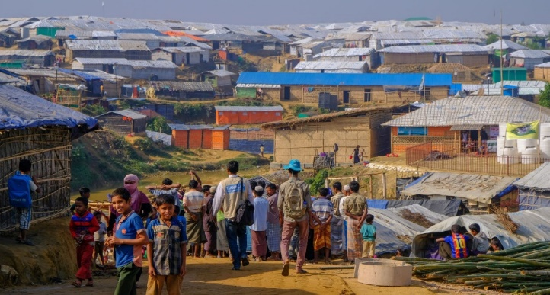
Motivation
1.2
Improve living conditions in Rohingya camps
Address rising security and crime issues
Promote long-term sustainability and economic self-sufficiency.
Leverage AI to optimize resource management and enhance security.
Foster refugee productivity and community integration.
Reduce dependency on host countries by empowering refugees economically.

Slide 8
Related Studies
1.3
Bhatia et al. (2018): Highlight inadequate facilities and limited economic opportunities in Rohingya refugee camps, but do not provide long-term solutions.
Milton et al. (2017): Focus on health challenges caused by overcrowding and poor sanitation, yet overlook socio-economic factors and the role of technology.
Karin et al. (2020): Emphasize food shortages, inadequate housing, and poor health service access but do not explore how technological advancements could address these issues.
Hossain et al. (2020): Address rising crime and the presence of armed groups in refugee camps, but do not consider how AI could enhance security.

Slide 9
Related Studies (cont.)
1.3
Where is the Research Gap?
There is a gap in current research that integrates sustainable living conditions with productivity and advanced technologies like AI, particularly in addressing basic needs, economic self-sufficiency, and social productivity.
This study proposes an AI-driven accommodation system to optimize resources, enhance security, and support economic integration in refugee camps, offering a globally adaptable model for humanitarian aid.

Slide 10
Research Objectives
1.4
Focus: AI-driven accommodation system for Rohingya refugees, integrating sustainability, productivity, and security.
Goals: Address living conditions, security and economic opportunities
RQ: How to develop an intelligent accommodation system for Rohingya refugee that supports productivity, ensures security, and leverages AI?

Slide 11
Research Contribution
1.5
Contribution: Proposes an AI-driven framework to improve living conditions, security, and productivity for Rohingya refugees, benefiting refugees, host communities, and policymakers with sustainable solutions.
Actionable Insights: Offers strategies for scalable, sustainable refugee accommodations that ensure safety and long-term resilience for both refugees and host nations.
Impact: Enhances productivity, reduces dependency, and eases the socio-economic burden on host countries.

Slide 12
02
Methodology
Search Strategy.
Selection Process.
Data Extraction & Synthesis.

Slide 13
02
Methodology
Method Used?
SLR
Why SLR?

Slide 14
Search Strategy
2.1
Databases: Searched IEEE Xplore, SpringerLink, ScienceDirect, ACM Digital Library, IGI Global, Google Scholar, and Wiley Online Library.
Keywords: Used Boolean operators like "Rohingya refugees" AND "accommodation system" AND "AI," and "AI in refugee security."
Citation Techniques: Forward and backward citation methods were applied to review references.

Slide 15
Search Strategy (contd.)
2.1
Inclusion Criteria: Peer-reviewed articles from 2000–2024 on refugee accommodation, AI,security.
Exclusion Criteria: Excluded non-peer-reviewed, unrelated AI/refugee studies, and articles lacking content or rigor.

Slide 16
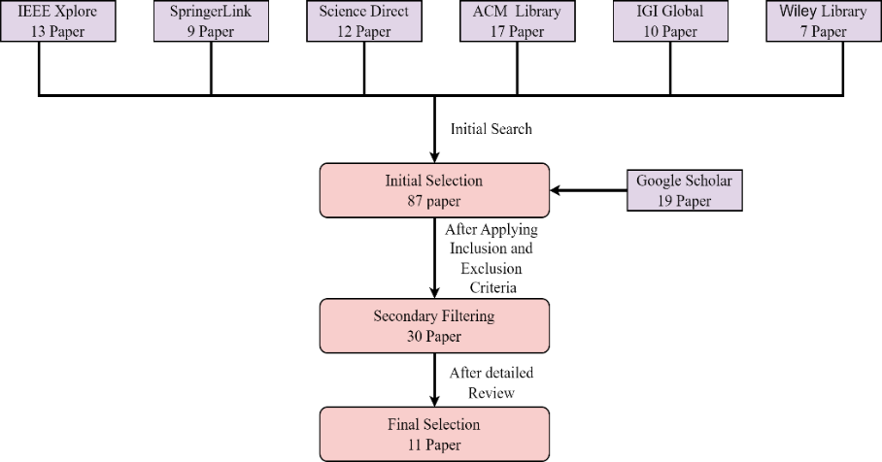
Selection Process
2.1
Initial Search: Identified 87 articles on AI, refugee accommodation, and security.
Screening: Applied inclusion/exclusion criteria, narrowing the list to 30 relevant articles.
Final Selection: Chose 11 studies based on direct relevance and methodological rigor.

Slide 17
Data Extraction and Synthesis
2.1
Data Extraction: Used a standardized form to collect data from abstracts, methods, results, and conclusions.
Restricted Access: Extracted key data from limited-access papers.
Quality Assessment: Evaluated studies based on citation count, journal impact, and methodological rigor to ensure high-quality inclusion.

Slide 18
03
Results & Analysis
Research Data/Results
Analysis & Discussion

Slide 19
Research Data/Results (contd.)
3.1
01
02
03
04
Alam et al. (2018)
Wardeh & Marques (2021)
Dala et al. (2018)
Sabie & Ahmed (2019)
Cloud-based system improves refugee management through centralized resource tracking and biometric identification.
Sustainable planning with local knowledge and technology improves health, education, and economic growth.
Improved refugee shelter design boosts productivity and security by incorporating urban planning.
Inclusive technology design can enhance resource access and security for refugees, especially women.

Slide 20
Research Data/Results (contd.)
3.1
05
06
07
08
Marji & Kohout (2022)
Hossain et al. (2020)
Easen & Binatli (2017)
İncetahtacı (2024)
AI can optimize camp organization, living conditions, and resource management.
AI-driven systems can improve security and productivity, with international cooperation needed for sustainability.
Refugee influx affects local labor markets; integration strategies can stabilize living conditions.
AI systems enhance productivity and address security concerns, fostering economic empowerment.

Slide 21
Research Data/Results (contd.)
3.1
09
10
11
Georgious et al. (2023)
Filipski et al. (2020)
Wolf (2014)
Refugee influx impacts labor markets, highlighting the need for secure and productive accommodation.
Addressing legal and cultural barriers can improve youth productivity and economic contributions.
Rohingya crisis threatens regional stability; addressing crime and radicalization is essential.

Slide 22
Analysis & Discussion
3.2
AI Central System
Optimize Resource Allocation.
Predict Security Threats.
Enhance Productivity & Integration.
Centralized Database.
System Security
Surveillance & Monitoring.
Biometric Identification.
Threat Detection.
Local Authority Collaboration.
Centralized Database Management
Biometric Identification.
Inter Agency Data Sharing.
Unified Refugee Profiles.
Resource Management
Allocate Supplies.
Waste Management.
Eco-friendly Technologies.

Slide 23
Analysis & Discussion (contd.)
3.2
Economic Empowerment
Vocational Training Programs.
Employment Opportunities.
Microfinance Support.
Digital Marketplaces.
Community Integration
Cultural Awareness Programs.
Education Initiatives.
Social Activities.
Education Programs.

Slide 24
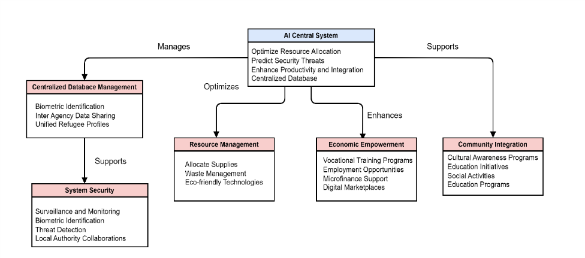
Analysis & Discussion (contd.)
3.2

Slide 25
04
Conclusion
Limitation
Future Scope

Slide 26
Conclusion
4
Framework: Proposes an AI-driven accommodation system for Rohingya refugees, enhancing living conditions, security, and economic opportunities.
Focus: Integrates AI with sustainable infrastructure for immediate relief and long-term self-sufficiency.

Slide 27
Conclusion
4
Limitations: Conceptual framework; lacks real-world testing.
Future Research: Needs practical implementation, scalability, and adaptability studies for broader application.

Slide 28
THANK YOU

Slide 29
Any Questions?

